Slide 1

DormDash
Student-Run Convenience Delivery Service
Created By: Mahek Parekh, Dora Do, Renee Zhu, Kunal Shah, Yue Su

Slide 2
Business Concept
DormDash is a student-run, on-campus delivery service that provides essentials—such as food, snacks, drinks, school supplies, and personal care products—directly to students in dorms and apartments.
Orders are easily placed online and delivered by student drivers, offering fast and convenient service.

Slide 3
Customer Value Proposition
DormDash offers reliable, affordable, and fast delivery of everyday essentials directly to students’ dorms and nearby apartments.
Designed specifically for campus life, it understands students’ schedules, locations, and needs.
By partnering with on-campus stores and using student delivery riders, it ensures quick service, lower costs, and consistent reliability—helping students save time, money, and effort during their busy schedules.

Slide 4
Business Statements
Vision
Transforming campus life by making everyday essentials more accessible and convenient for students.
Mission
DormDash provides college students living on campus with fast, reliable, and affordable delivery of everyday essentials, including food, drinks, school supplies, and personal care items. By partnering with on-campus businesses and employing student drivers, DormDash offers a more convenient, cost-effective, and student-focused alternative to traditional delivery services.
Core Values
  Put Students First: DormDash places students at the center of everything we do by ensuring our services are convenient, affordable and reliable.
  Speed and Quality: We are committed to fast delivery while maintaining high-quality service, ensuring students receive what they need in a timely manner.
  Accessibility and Affordability: We maintain competitive pricing and support accessible payment options to ensure our services are available to all students.
  Community Focused: DormDash strengthens the campus community by partnering with local and on-campus businesses.
  Integrity and Reliability: We build trust through consistent, honest service by delivering what we promise, when we promise it.

Slide 5
Financial and Strategic Objectives
Financial Objectives
Earn $130,000 in total sales revenue by the end of the first year of operation
Reach positive monthly cash flow by month 6 of operation
Pay off half of borrowed debt within 2 years of full operation
Strategic Objectives
Increase monthly active app users by at least 150 customers per month during the first year of operation
Grow Instagram and Tiktok platforms to a total of 10,000 followers by the end of the first full year of operation
Partner with at least five local grocery and convenience stores within the first 12 months of operation.

Slide 6
CSR Strategy for Global Expansion
Key Initiatives
Sustainable Delivery Methods
  Implement low-emission delivery options (E-scooters, bikes)
  Reduces environmental impact as operations expand
  Meets global sustainability expectations
Fair Employee Commitment
  Provide fair wages, flexible scheduling , and safe working conditions
  Complies with local labor laws and employment standards
  Improves retention and strengthens employer brand
Reduce Campus Waste
  Partner with universities and local vendors
  Redistribute surplus food to students and local communities
  Support sustainability goals and social impact
Strategic Role of CSR in Global Expansion
  Builds trust in new international markets
  Strengthens brand reputation across global markets
  Supports long-term scalability and partnerships
  Aligns with local cultural and environmental expectations

Slide 7
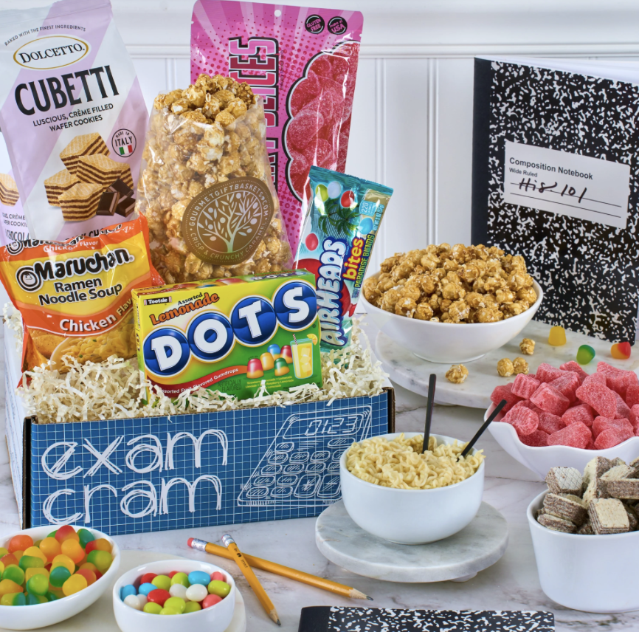
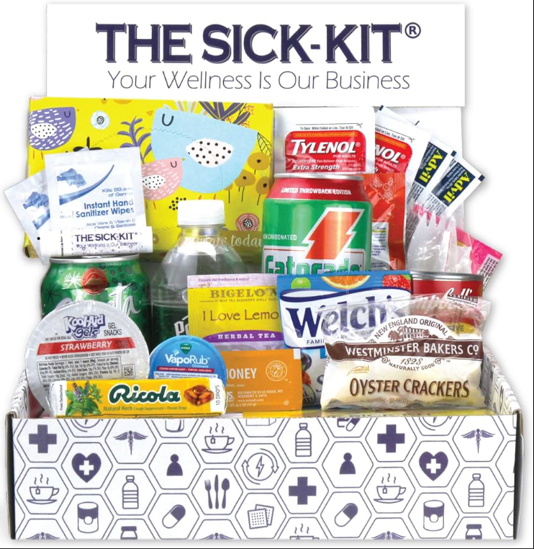
New Product: DormDash Care Bundles
Product Overview
Key Benefits
Strategic Value
Pre-built care packages available for on-demand purchases
Designed to meet common students needs (finals, sick days, self care)
Available for purchase by both students and parents
Provides convenient, ready-to-use solutions
Utilizes existing delivery systems
Tailored to student needs
Increases average order value through bundled pricing
Expands target market to include parents
Supports scalable growth across campuses
Generates higher margins through bulk purchasing
Example Bundles
  Finals Package: energy drinks, snacks, flashcards
  Sick Day Kit: medicine, soup, tissues
  Self Care Box: skincare, candles, snacks
Finals Package Example
Sick Day Kit Example

Slide 8
National Expansion Decision & Approach
Expansion Decision: YES
  Scalable business model that can be replicated across college campuses
  Large addressable market with over 4,000 universities
  Expanding early helps prevent competitors from entering the market
Rationale
  Supports growth while managing operational risks
  Maintains service quality and brand consistency
  Captures first-mover advantage in growing market
Expansion Approach
Raise Capital → Hybrid Expansion Model
  Raise capital to support initial expansion phase
  Launch operations across 15-25 campuses
  Transition to selective franchising
Why This Approach
  Builds stronger operational systems before scaling
  Establishes brand reputation and track record
  Retains revenue in high-potential markets

Slide 9
Global Expansion: Country Selection & Rationale
Country Selection: CANADA
  Geographic proximity to the U.S.
  Stable legal and regulatory environment
  Similar student demographics and campus culture
Opportunities
  High concentration of universities and student population
  Cultural similarities allows for faster market adoption
  Efficient logistics and supply chain coordination
Limitations
  Harsh winter climates, may impact delivery operations
  Competitive food delivery market
  Bilingual requirements in certain regions of Canada (Quebec)
Overall Rationale
  Predictable and scalable expansion environment
  Strong alignment with DormDash’s business model
  Low political, cultural, and economic risk
  Provides an ideal first step into international expansion

Slide 10
Global Expansion: Strategy & Entry Mode
Entry Strategy: Joint Venture
Approach
  Partner with local Canadian businesses
  Leverage local expertise
  Maintain standardized core operations while allowing strategic local customization
  Captures advantages of both strategies while minimizing disadvantages
Rationale
  Ensures consistent service quality across markets
  Local partners provide cultural insight and market credibility
  Reduces market entry risks by sharing resources with local partners
Expansion Strategy: Combination Strategy
Rationale
Maintains consistent brand identity and service models across markets
Adapts to local preferences, campus environments, and regulations
Provides flexibility to meet different student needs in each country

Slide 11
Key Job
Job Selected: Delivery Driver
Key Responsibilities
Pick up and deliver orders quickly and safely
Ensure accurate delivery
Maintain professional service
Communicate order status
Follow local laws and traffic regulations
Qualifications:
Must be 18+ years old
ability to walk, bike, or drive for entire shift
Reliable smartphone with data plan
Valid driver’s license
Valid insurance and registration for vehicle
Ability to work evenings and weekends
Compensation Plan
$15 - $18 per hour
Tips from customers
Performance-based bonuses
Advertising Plan
Target college students/ young adults/parents
Post available jobs on Handshake, LinkedIn, job boards
Utilize DormDash social media platforms (Instagram, TikTok)
Selection Criteria
Reliable transportation and communication
Availability during peak hours
Strong time management
Clean driving record

Slide 12
Employee Motivation Initiatives
Flexible Scheduling
  Implement flexible scheduling to support student work-life balance
Performance-Based Incentives
  Provide bonuses for high customer ratings and performance
Career Advancement
  Create a clear path for internal promotions and leadership roles
Open Feedback
  Conduct regular surveys and team meetings to gather feedback from employees and improve operations

Slide 13
Annoucement for Employee Departure:
Two team members have recently resigned, effective immediately. We appreciate their contributions and wish them the best in their next endeavors.
To better support our team going forward, DormDash will implement:
  Recognition based incentive programs (“DashStar of the Month”)
  Training and development programs
  Performance-based bonuses and incentives
  Flexible scheduling and career advancement opportunities
  Employee feedback systems
Our goal is to create a supportive and motivating work environment for our employees.
Best regards,
DormDash Management Team

Slide 14
Key Drivers & Actions for Employee Engagement
Key Drivers for Employee Engagement
Actions DormDash Will Take
Clear communication
Recognition and appreciation
Growth and development opportunities
Fair rewards and flexible scheduing
Hold weekly team check-ins and provide clear scheduling
Recognize strong performers (e.g., “Employee of the Month”)
Create a clear path for advancement into higher position (e.g., promotion timeline)
Provide flexibility scheduling around student needs
Provide performance-based incentives (e.g., bonuses for high customer ratings)

Slide 15
SIPOC Process Map
Suppliers | Inputs | Process | Outputs | Customer
Restaurants/Campus dining halls Retail partners (Campus stores) App platform provider DormDash drivers | Customer order (App) Menu/Item availability Driver availability Delivery location and payment | Customer places order (App) Order sent to restaurant/store Order prepared Driver is assigned and picks up order Order delivered to dorm/apartment Customer confirms receipt and rates service | Delivered order Order confirmation Customer rating/feedback | Who: College students living in campus dorms/apartments Desired Customer behaviors: Positive reviews/ ratings Repeated usage of DormDash app Word-of-mouth referrals Requirements: Accurate orders. Affordable pricing. Fast delivery. availability during midterm/final season. Easy process to place orders.

Slide 16
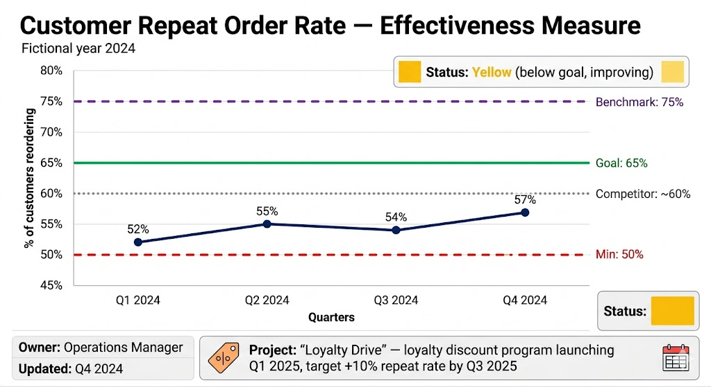
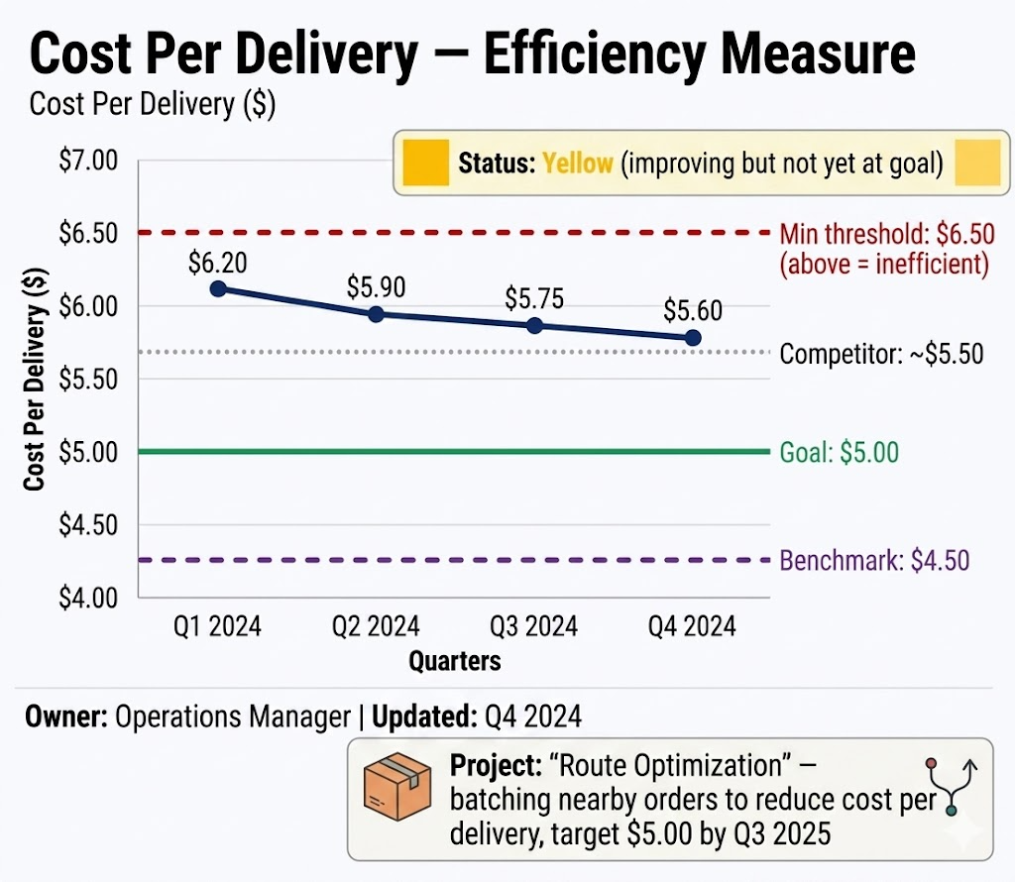
Effectiveness & Efficiency Measurement Chart

Slide 17
Route Optimization Initiative
Problem
  High delivery cost per order
  Inefficient routing during peak hours
  Slower service reduces repeat orders
Initiative
  Group nearby deliveries into one trip
  Optimize driver routes to reduce travel time
  Improve driver productivity and efficiency
Expected Outcomes
  Lower cost per delivery
  Faster delivery times
  Higher repeat order rate
  Improved customer satisfaction
Target: Reduce overall cost per delivery to $5.00 and improve DormDash customer retention.

Slide 18

Whether to Sell DormDash or Not?
Decision: Not to Sell
Financial Consideration
Sale would generate substantial returns for both major and minority shareholders
However, short-term financial gain does not outweigh long-term brand value
Operational Risk
New owners lack industry experience → high risk of mismanagement
Service quality decline threatens DormDash's core value proposition
Human Capital Impact
Acquisition will likely trigger extensive employee layoffs
Damages relationships with employees, customers, and delivery partners
Strategic Conclusion
Retaining ownership preserves long-term growth trajectory
Aligns with DormDash's mission and ethical responsibility to all stakeholders

Slide 19

Summary—Why DormDash Has Been Successful
Core Strengths
  Solves a real and immediate need for college students
  Offers affordable, reliable, and campus-focused delivery
  Built on a clear mission, values, and strategic objectives
Growth Potential
  Expands revenue through products like Care Bundles
  Scalable across U.S. campuses through a hybrid expansion model
  Well-positioned for international growth, beginning with Canada
Long-Term Advantage
  Strengthened by CSR, employee-focused practices, and process improvement
  Supported by efficiency and effectiveness measurement systems
  Designed for sustainable and scalable business growth

